Slide 1
AntiScammer
(UXI 2019 project)
Marios Pafitis
Leonidas Achilleos

Slide 2
General Information
Project Goal:
AntiScammer is a website that helps you decide whether the exchange rate of an exchange place is good or not.
Steps:
Choose the currency of your money
Choose the currency you want to exchange
Write the amount you want to exchange
Write the amount that they will give you for your money
That’s all! You already have the result, and you can decide whether you should exchange money or not.
Used Technologies & Tools:
Prototyping:
Photoshop, Drawings in paper
Implementation:
HTML, CSS, JavaScript, Bootstrap 4, Animate.css

Slide 3

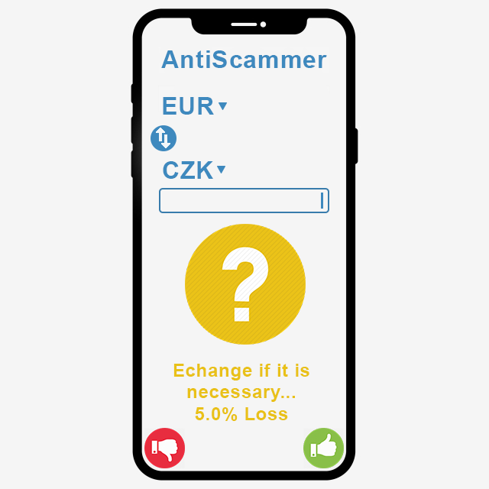
Design Preliminaries
Rectangular model:

Slide 4
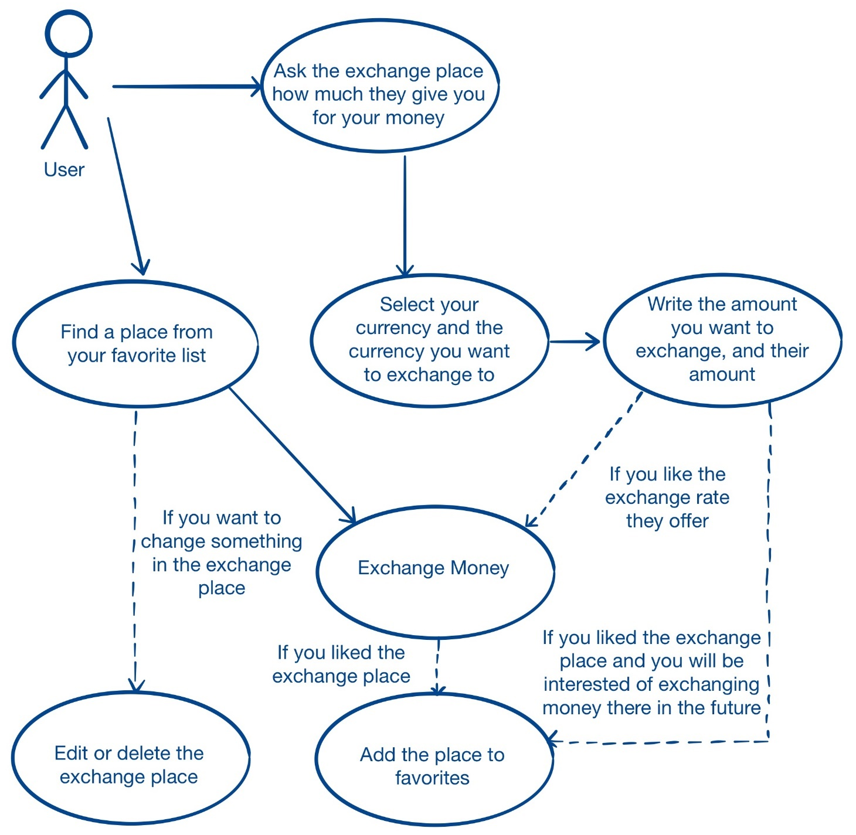
Design Preliminaries
User case analysis:

Slide 5
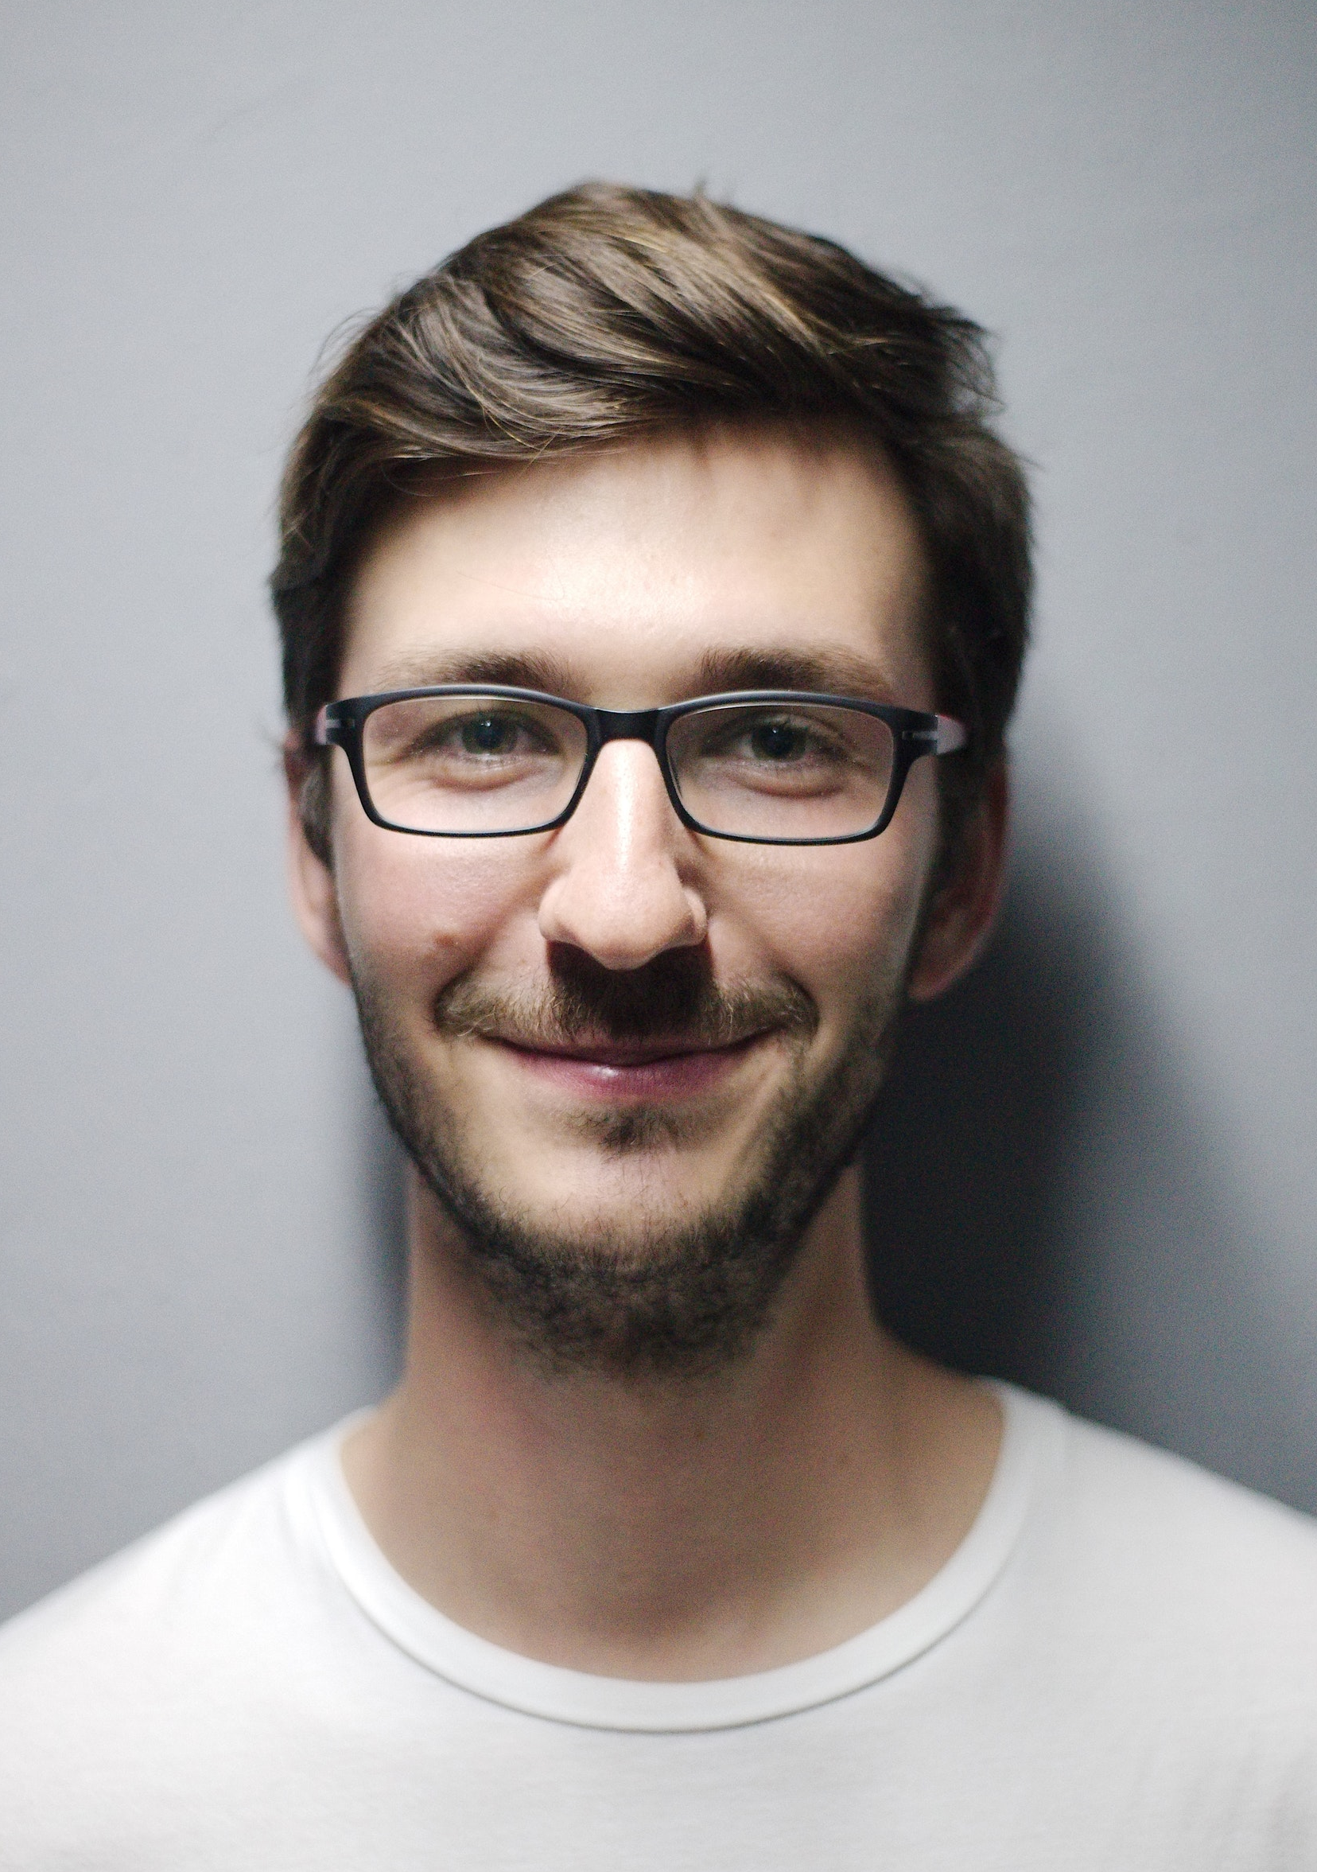
Matthew Adams
Persona 1:
Matthew doesn’t have the economic comfort to book luxury hotels or rent cars. So, do not mistake him for a regular tourist.
He is the guy that would walk for 20 minutes just to find the cheapest souvenir shop in the city.
His relationship with technology is very good, but he also has high expectations from it. He believes that his smartphone can satisfy most of his travel needs (regarding maps, cheap communication, transportation etc).
Age: 20 years old
Studies: Engineering
Hobbies: Travelling

Slide 6
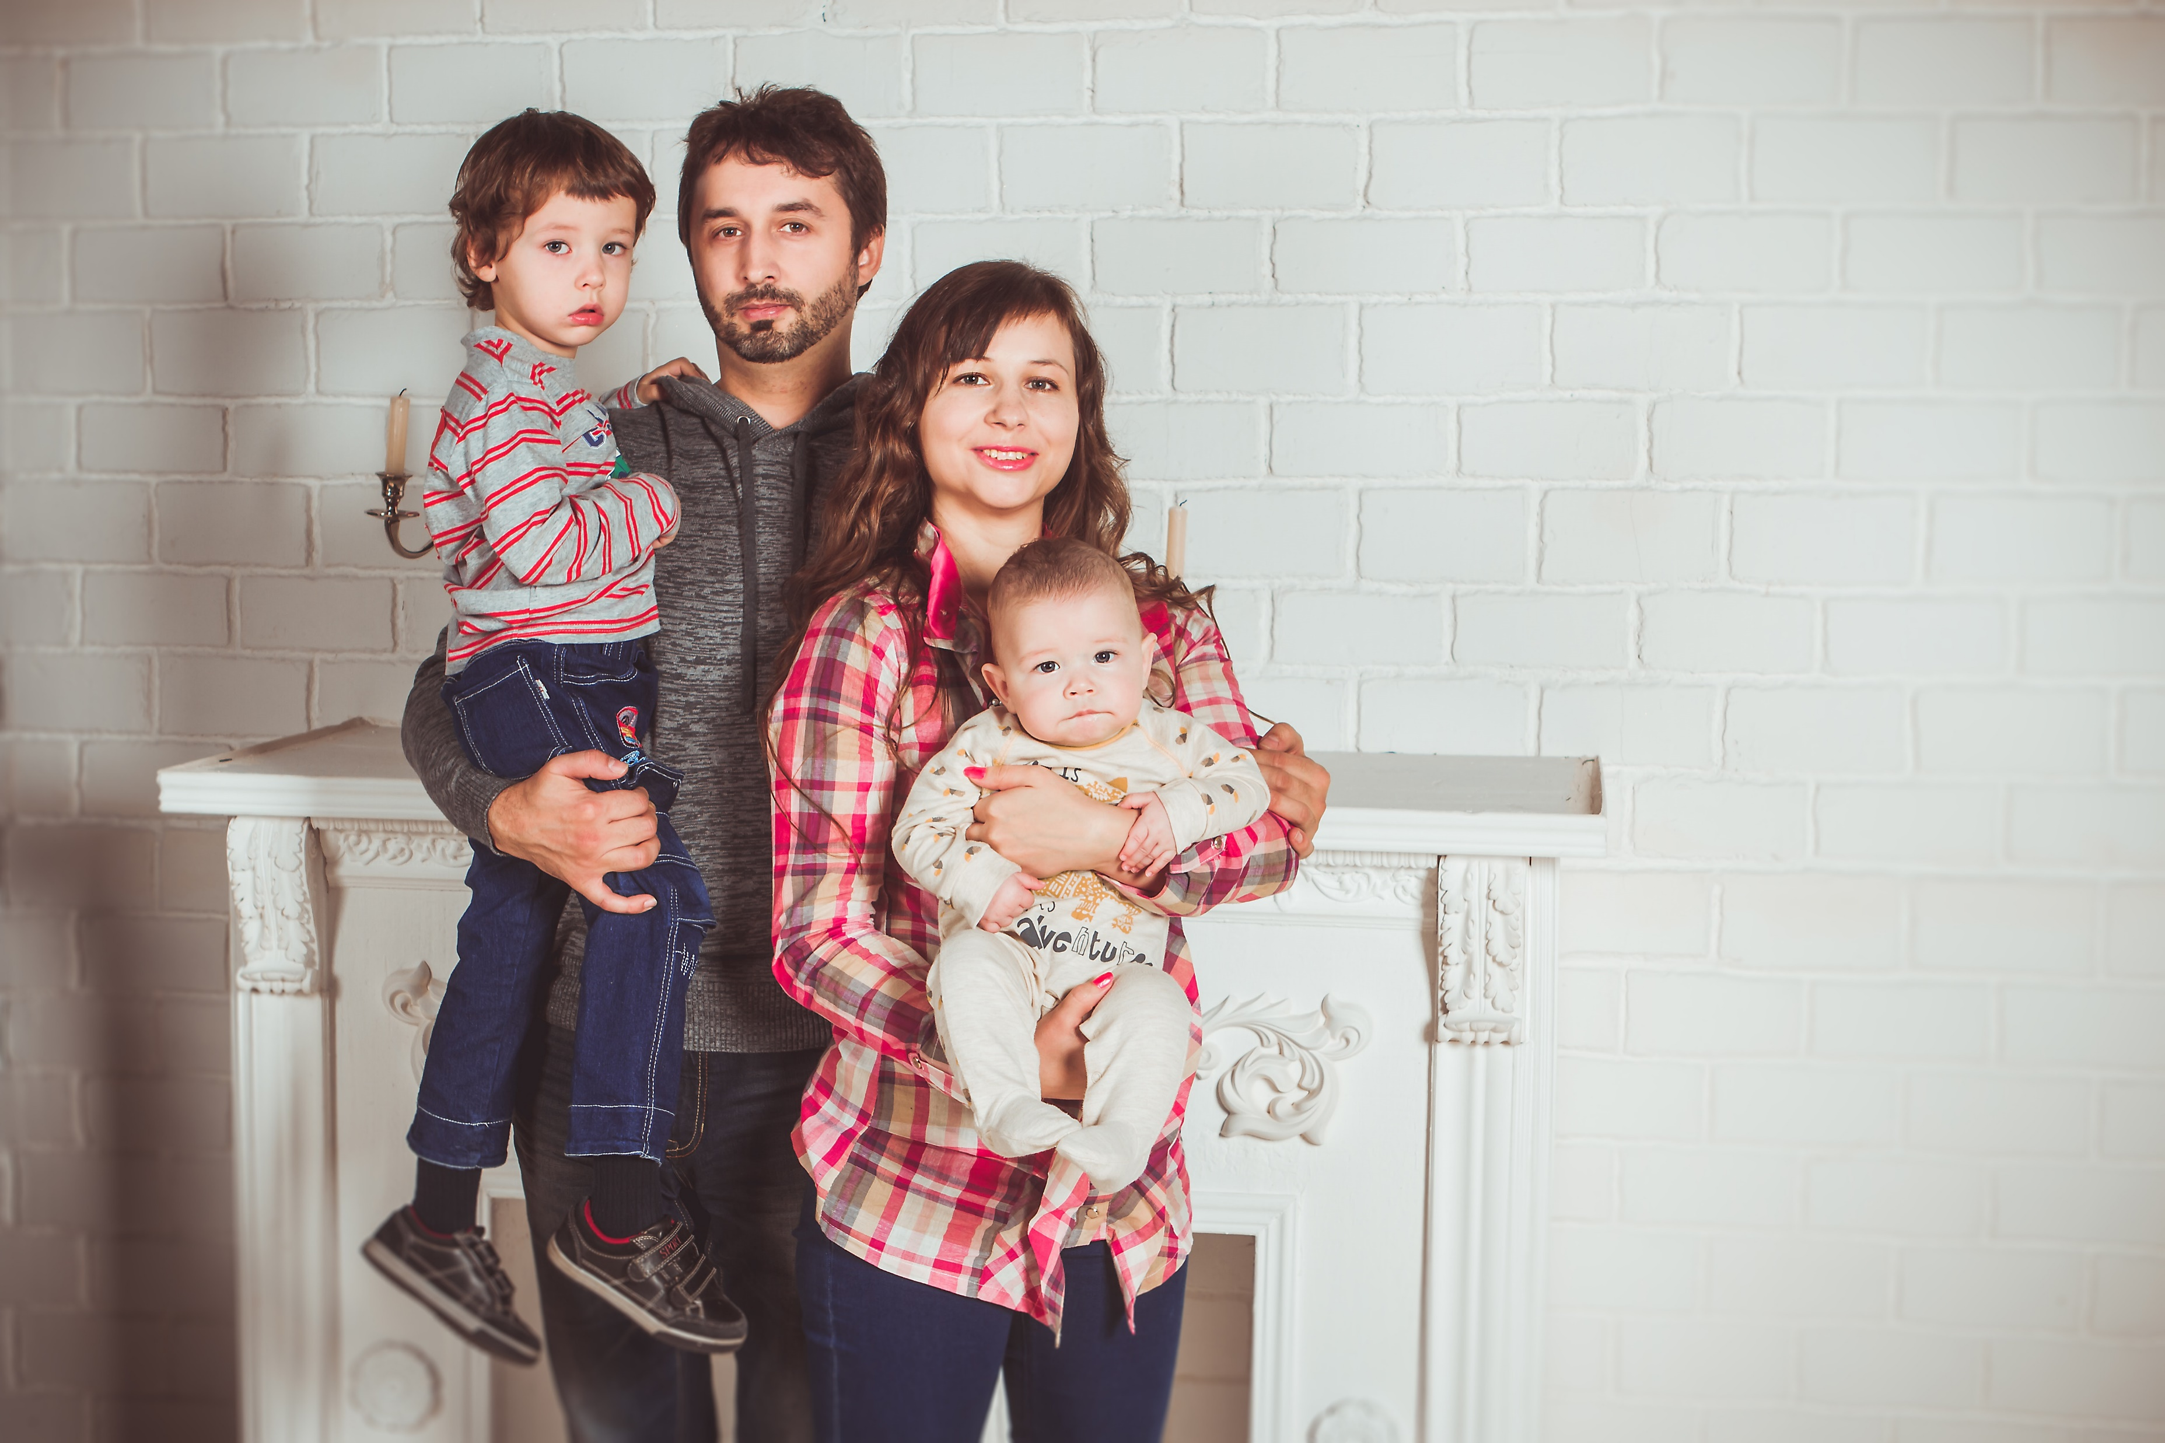

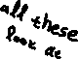
Shelby Family
Persona 2:
This is the Shelby Family. It’s a middle class family with 2 kids.
John, the father, is working for at least 8 hours a day, in an office position. He really loves his family, even if it is making him more tired all the time. He has some experience with technology, but we wouldn’t really call him a “Guru of Tech”. When the new year steps in, the only thing that he is really looking forward to, it’s his family vacation in Greece.
Always by his side, his wife Marie. She works a part time job in order to help her husband, but she devotes most her time to their kids. Regarding technology, she always asks her husband to help her.
Their vacation time is around 10 days a year. And for them it is never enough. They are always look for new ways to manage their time better, and have more money to spend in activities with their kids.

Slide 7
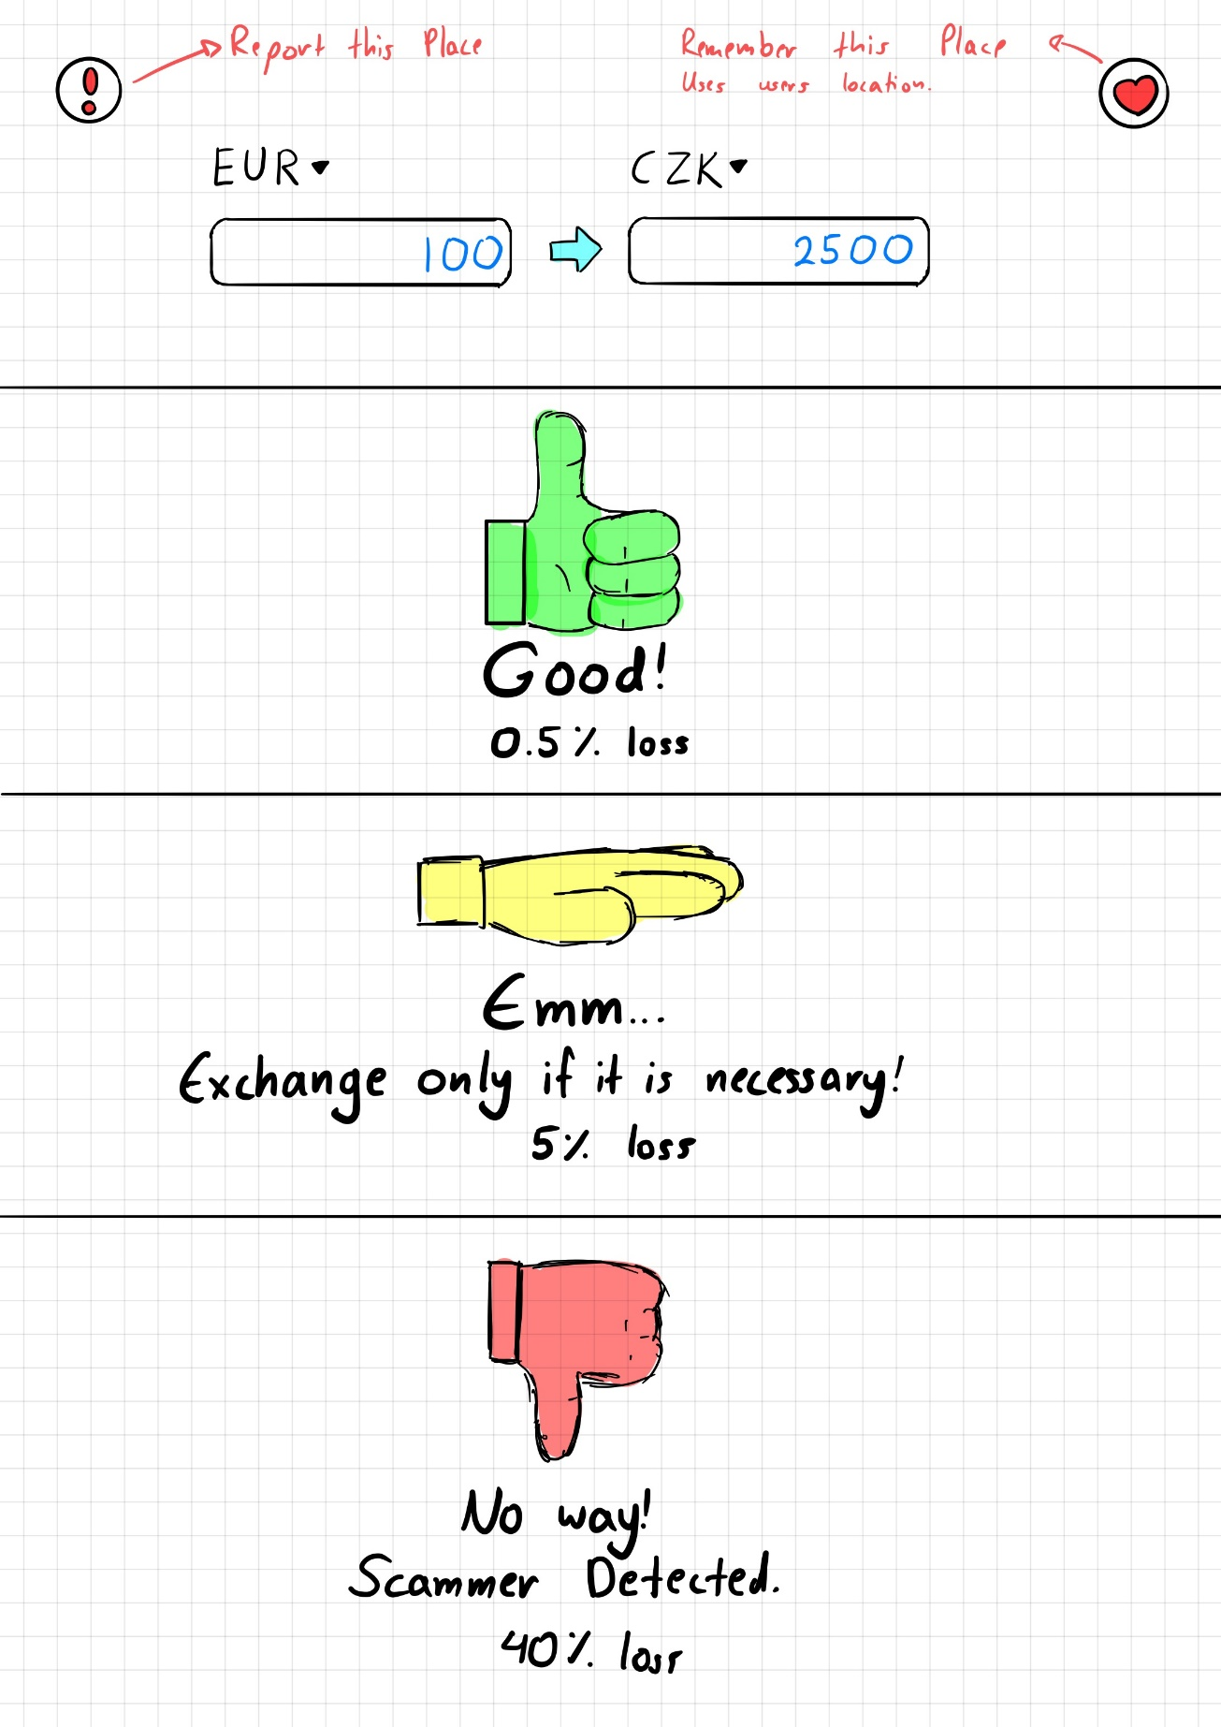
Prototype 1
Single screen
Doesn’t give to the user the freedom to choose
Report/Remember a place
3 possible Results

Slide 8
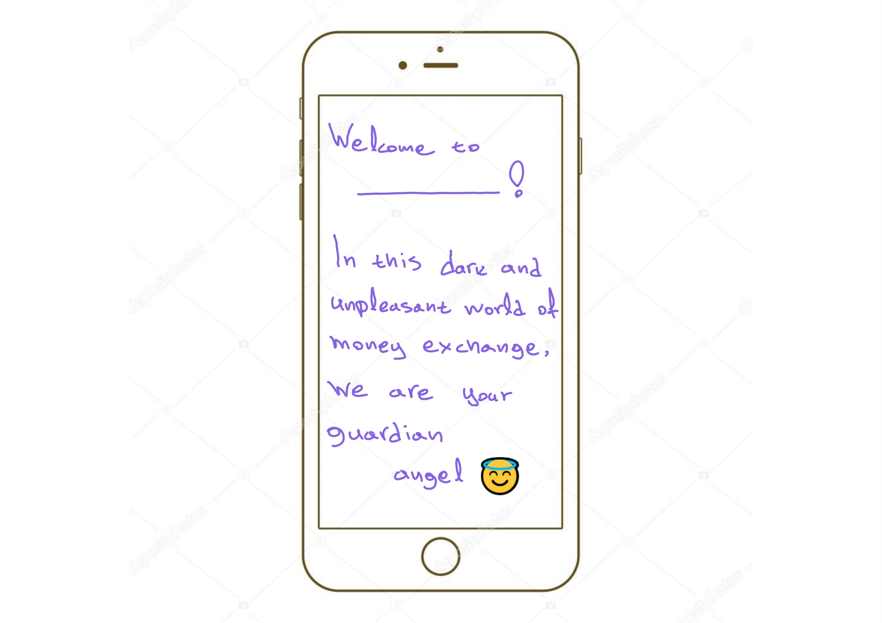
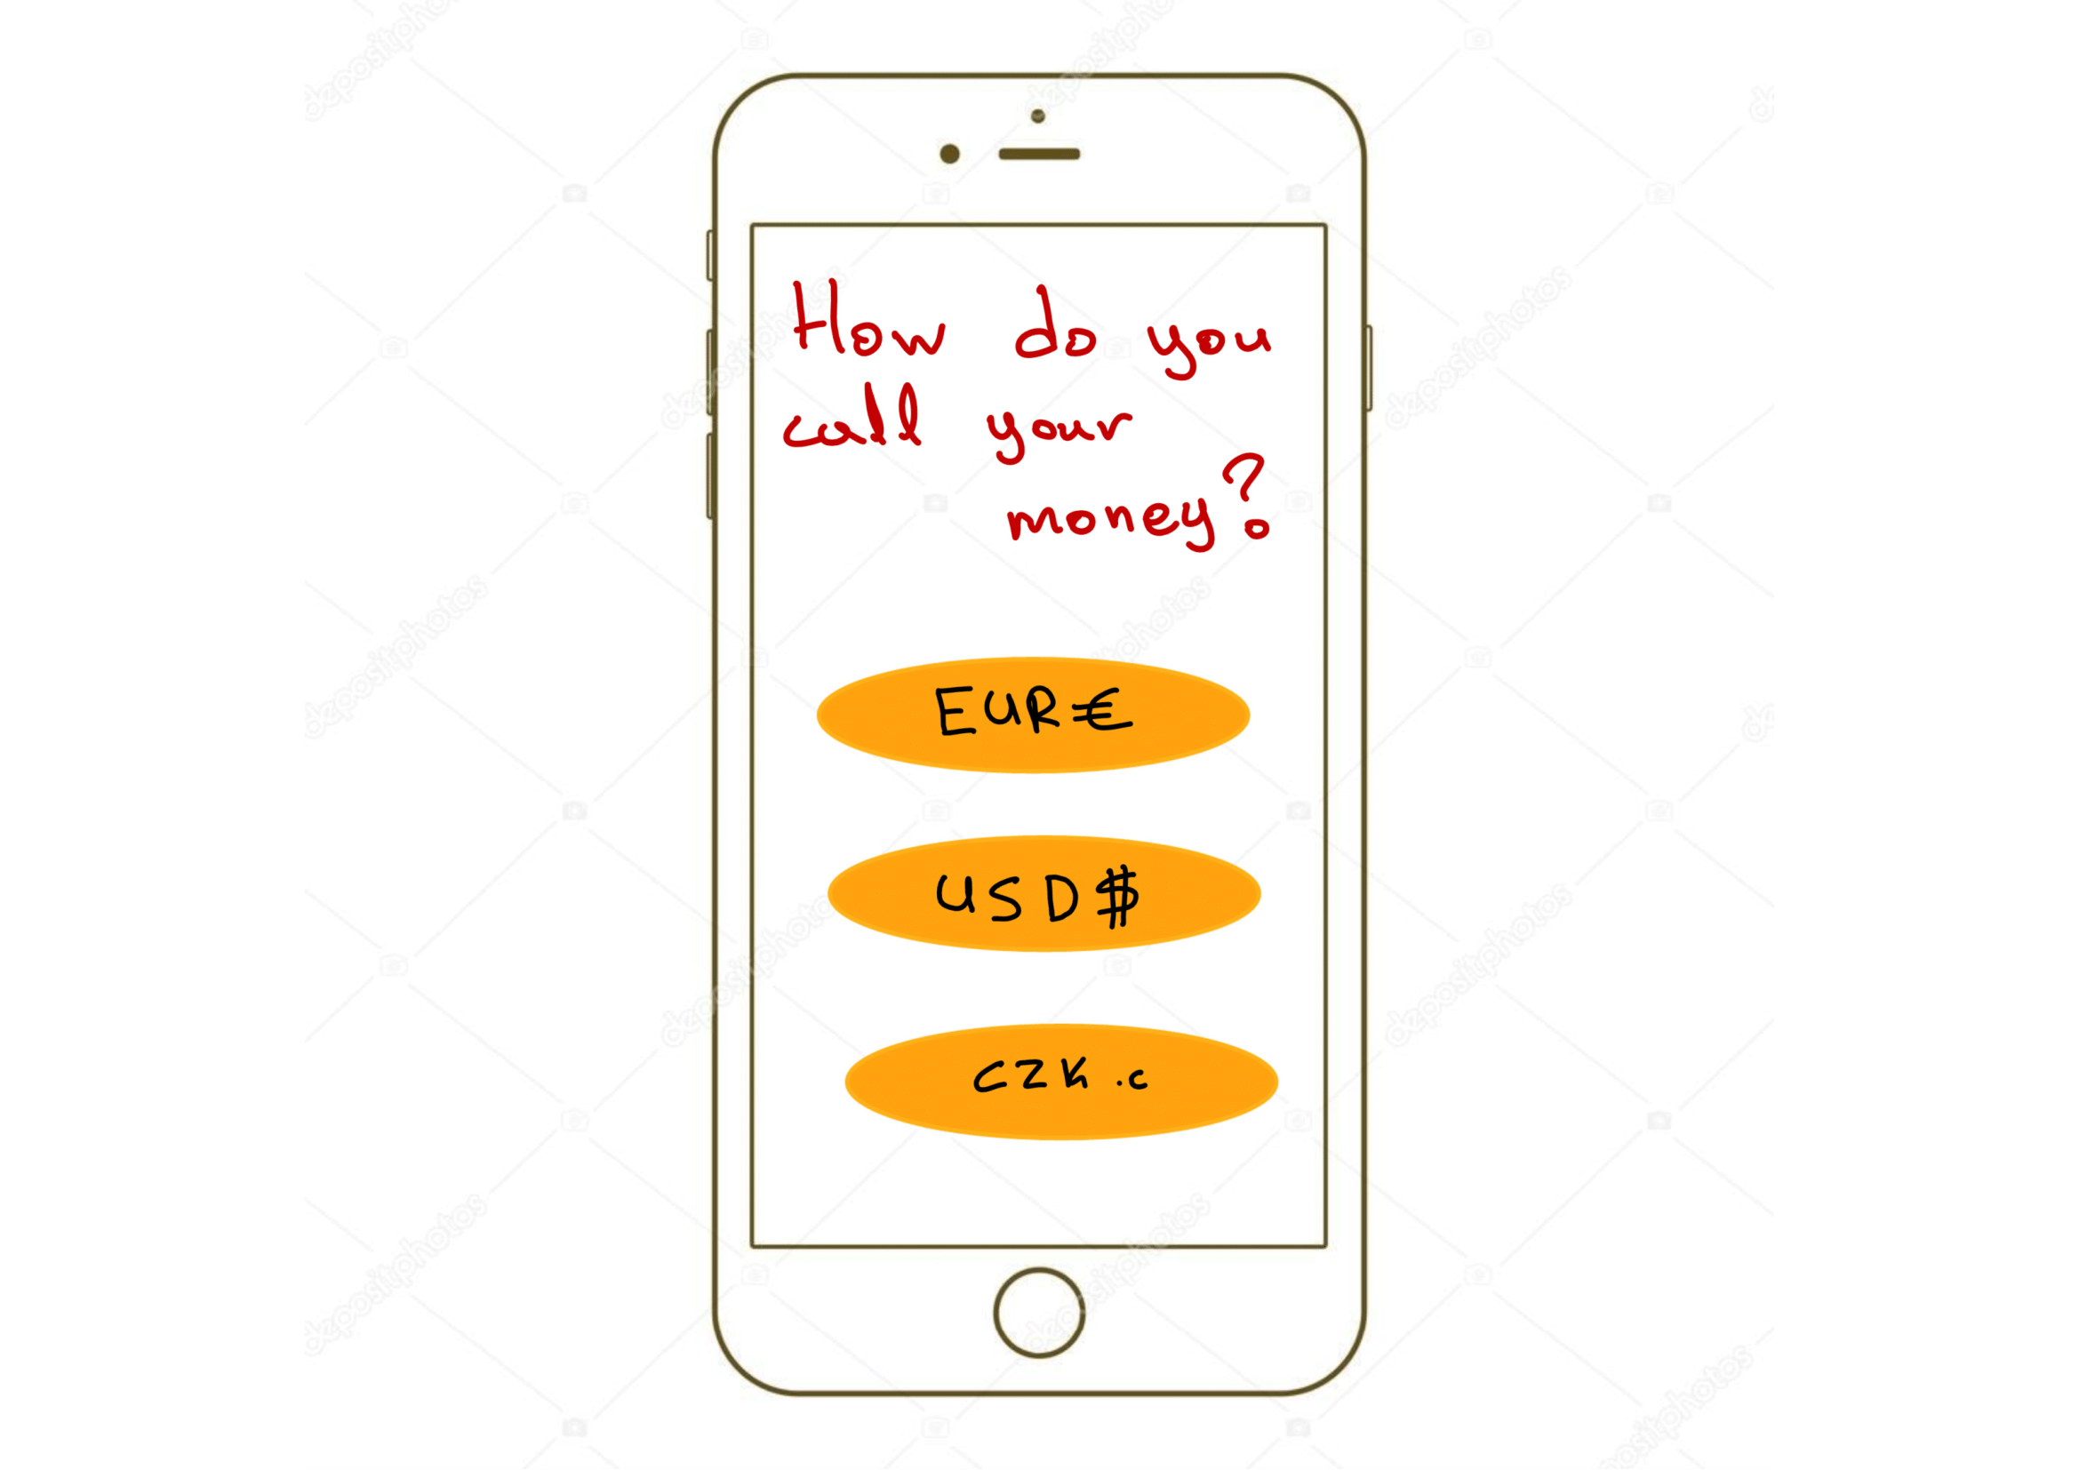
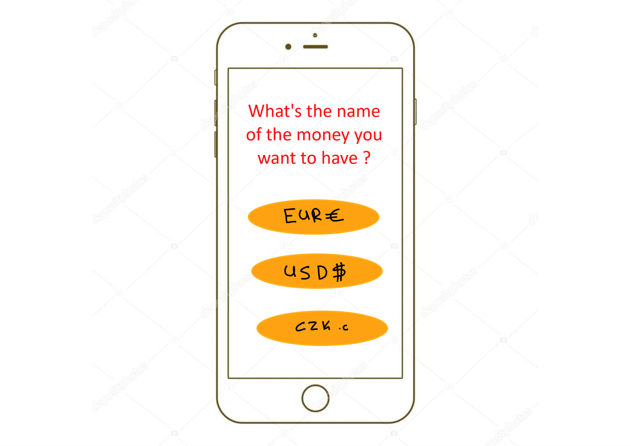
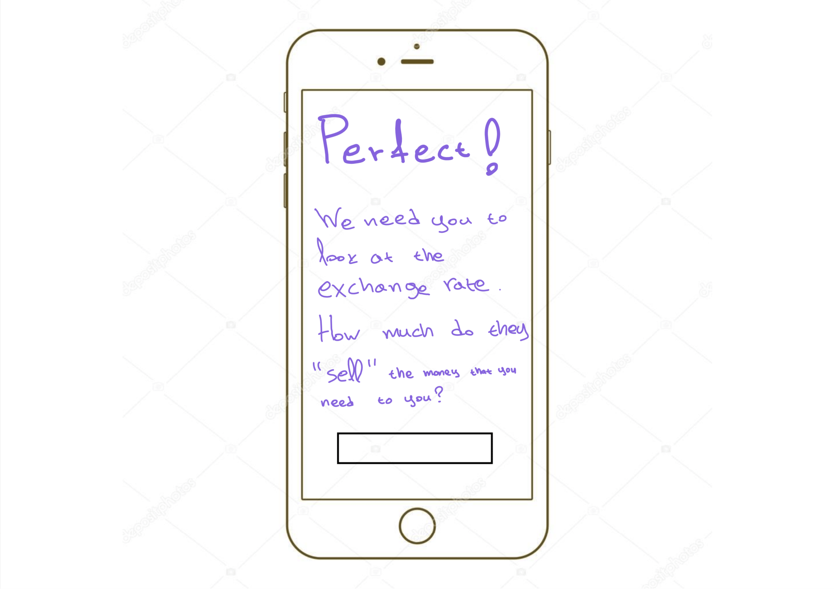
Prototype 2
Multiple screens
Too much text –Confusing

Slide 9
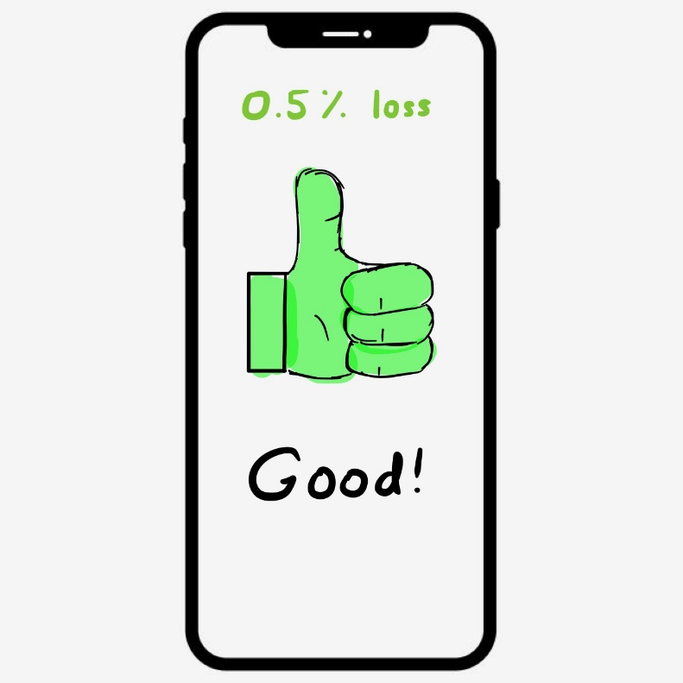
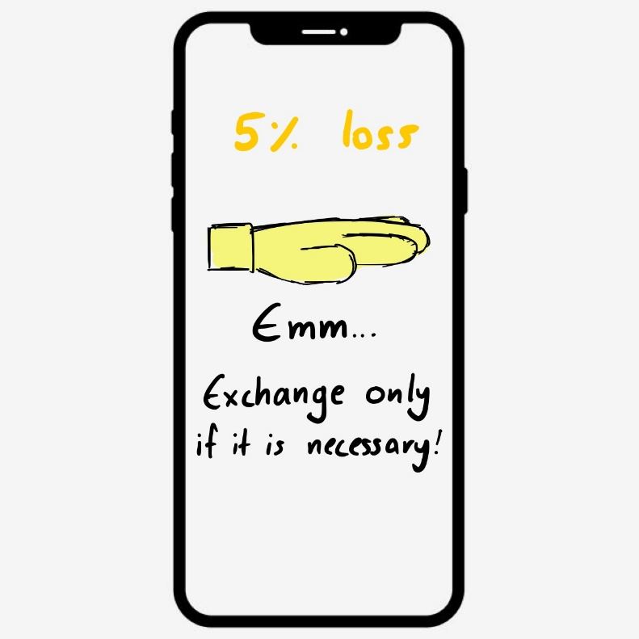
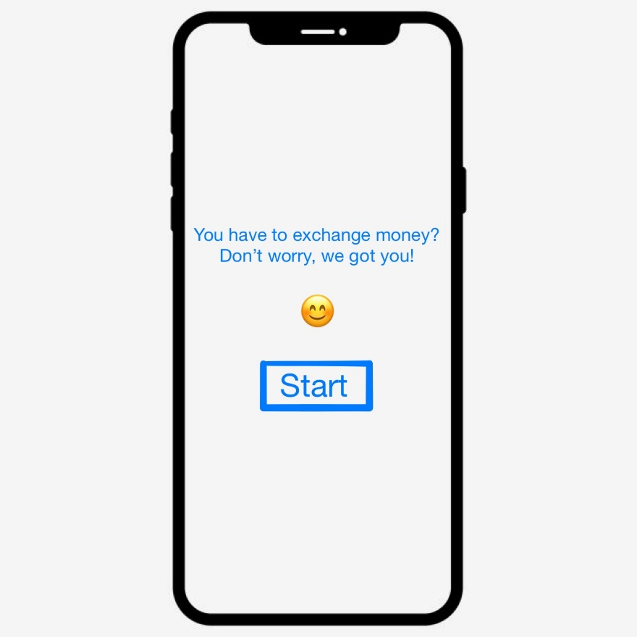
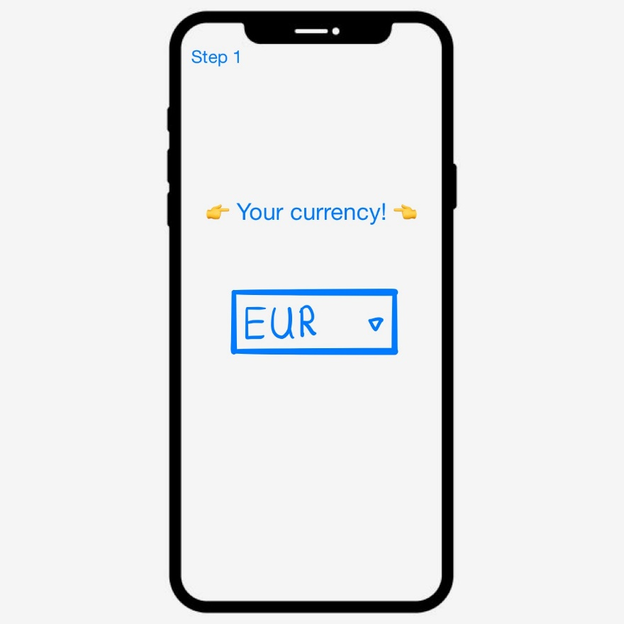
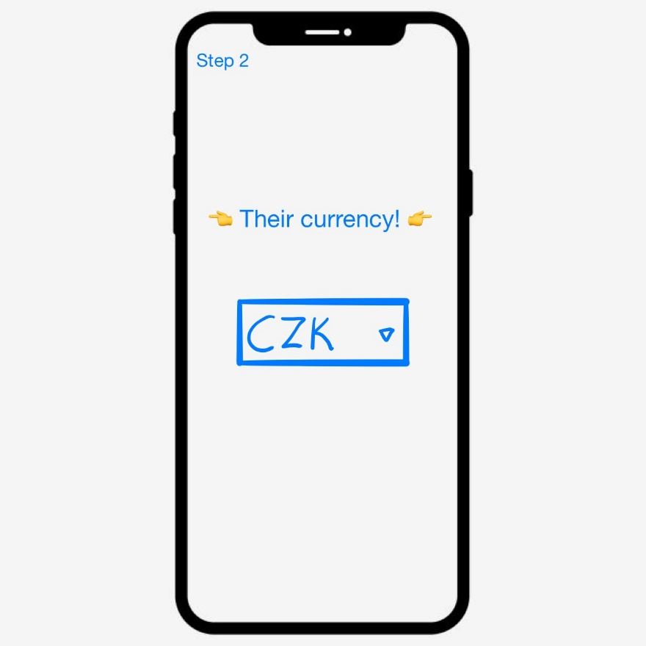
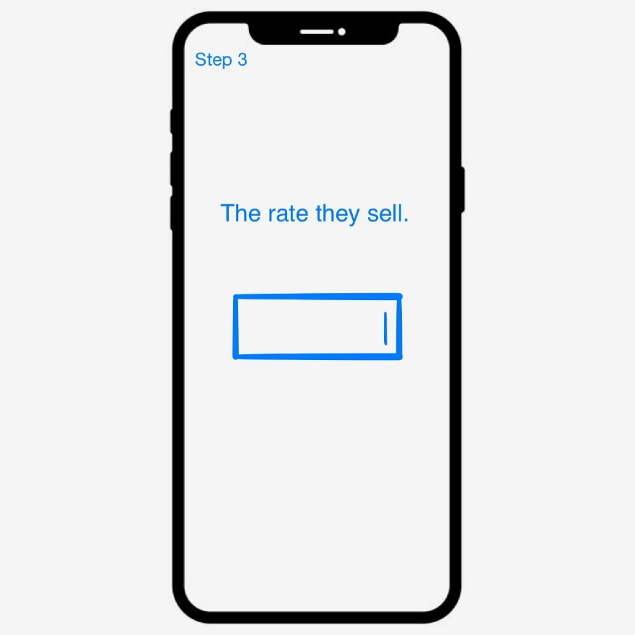
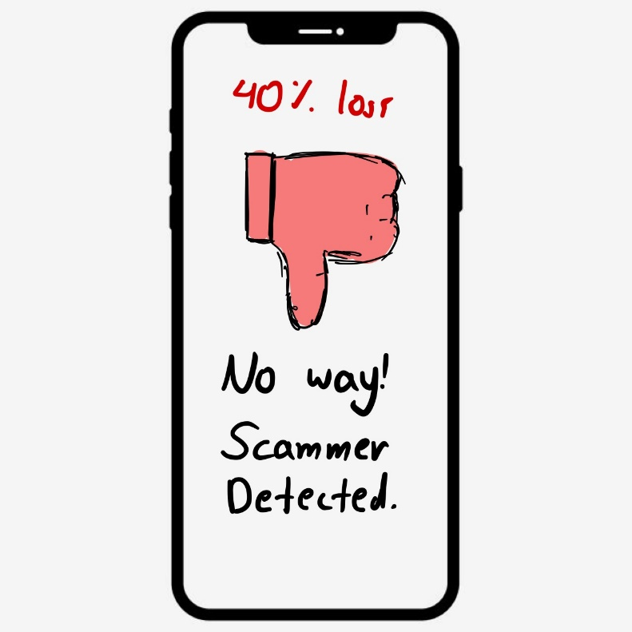
Prototype 3
Multiple screens
Less text – still Confusing

Slide 10
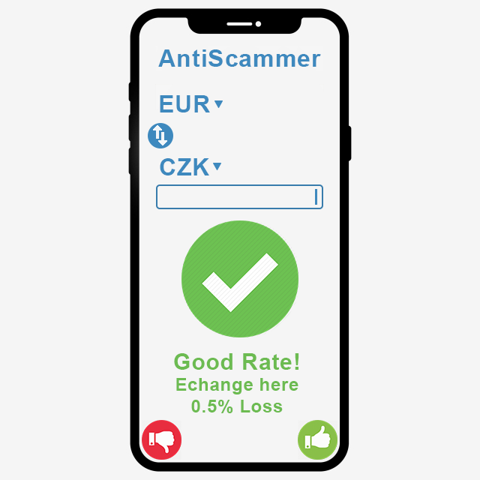
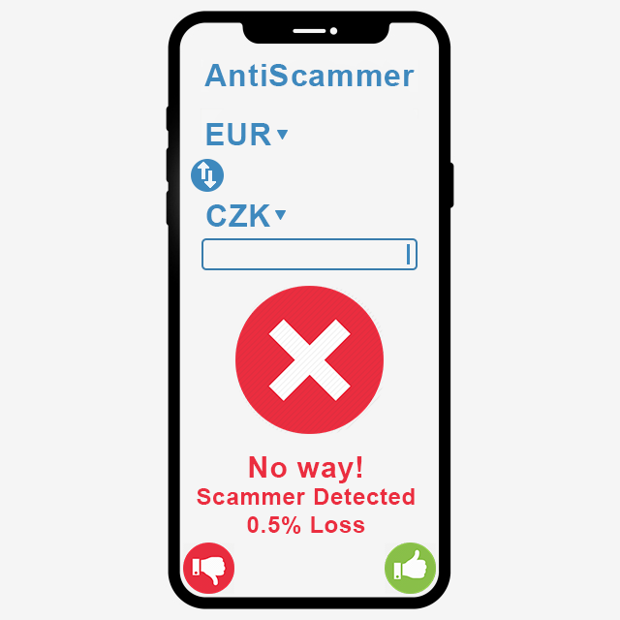
Prototype 4
Single screen
Like/Dislike Buttons
Compares rate and not amount of money that you want to exchange
Drop down menus
Flip

Slide 11
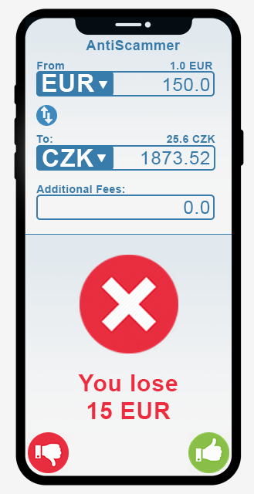
Prototype 5
User has the freedom to choose
(How much money you will lose)
Compares amount and not rate
Additional fees input box
Tells the rate for the currencies

Slide 12
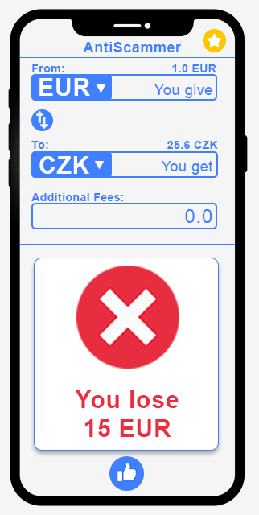
Prototype 6
Like button (Add to Favorites)
Star button (Favorites menu)

Slide 13
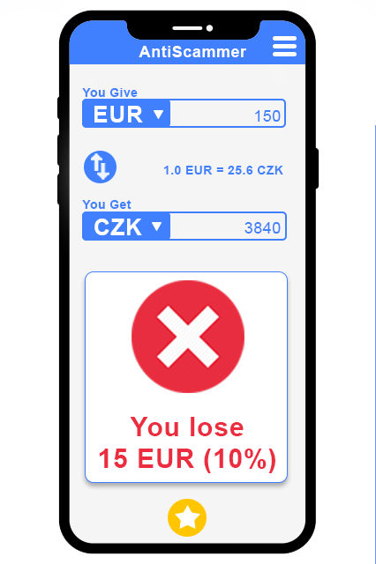
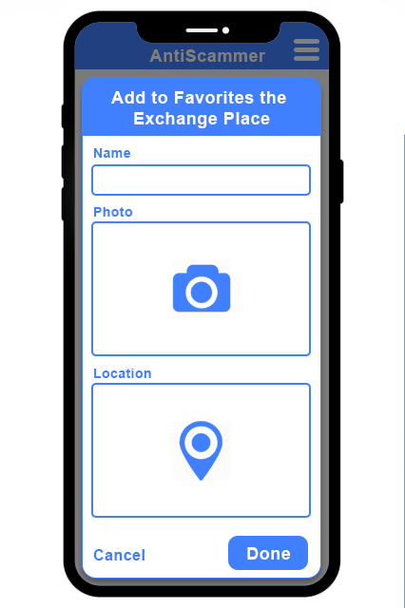
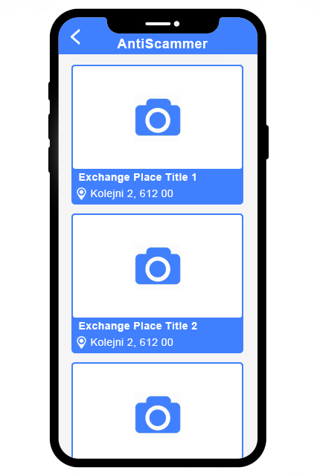
Prototype 7
No additional fees
Star button (Add to Favorites)
Three bars icon (Favorites)
Start Screen
Add to Favorites
Favorites Menu

Slide 14
Early Testing
Question:
What is the usage of this application?
Answer:
Check how mush you are going to lose if you exchange money with a specific rate.
Task 1:
We give you 26 CZK for 1 EUR, where are you going to put the data to check if it’s worth it?
Result 1:
Task 1 completed successfully
Task 2:
You liked the place and you want to add it to favorites.
Result 2:
The guy pressed the star button => Task 2 completed successfully

Slide 15
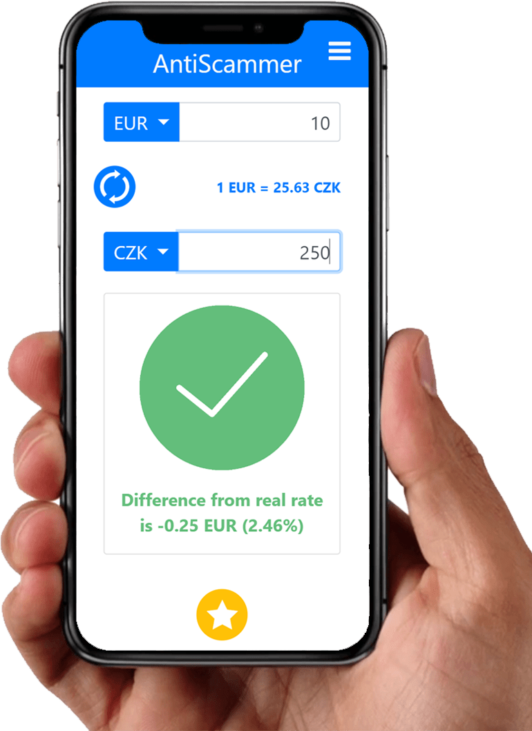
Final Version of AntiScammer (Real Photo)

Slide 16
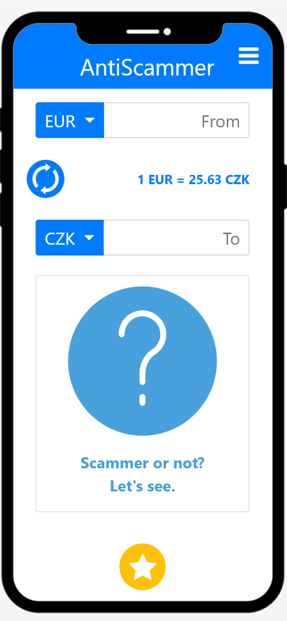
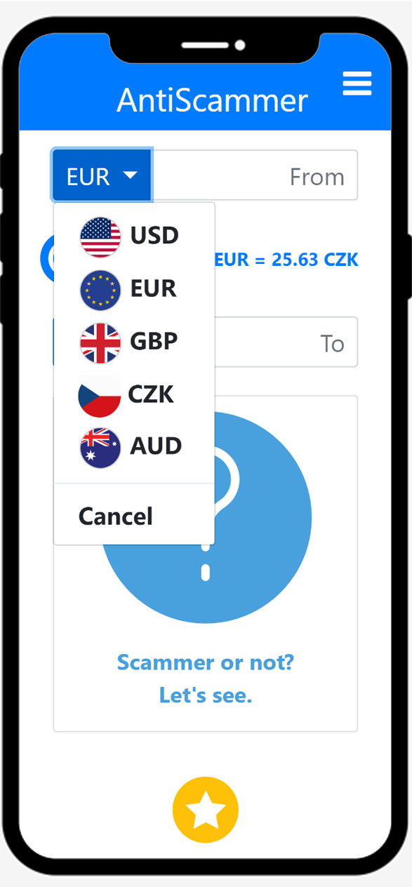
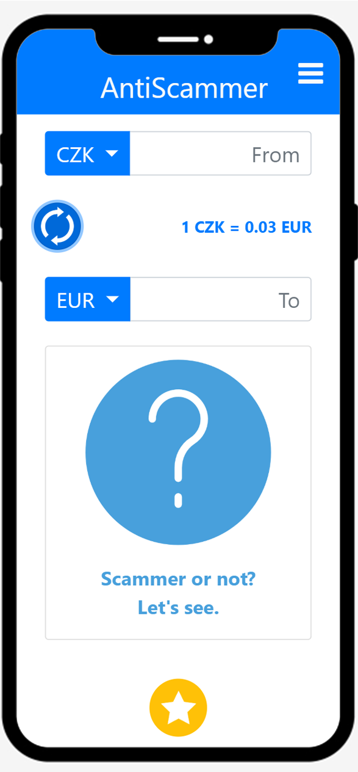
Final – Start Screen
Start Screen
Select Currency
Flip Currencies

Slide 17
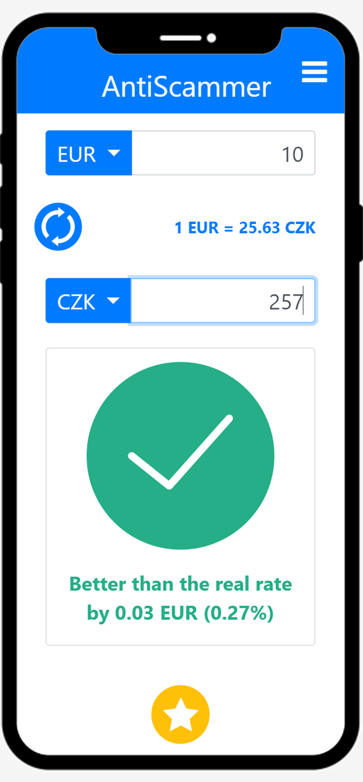
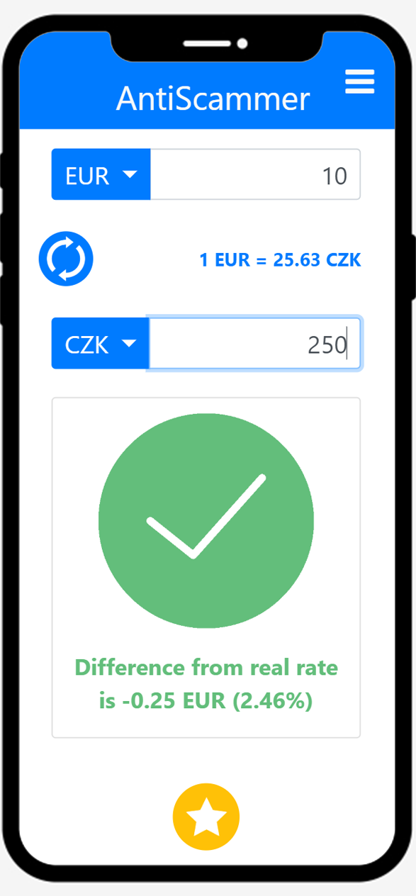
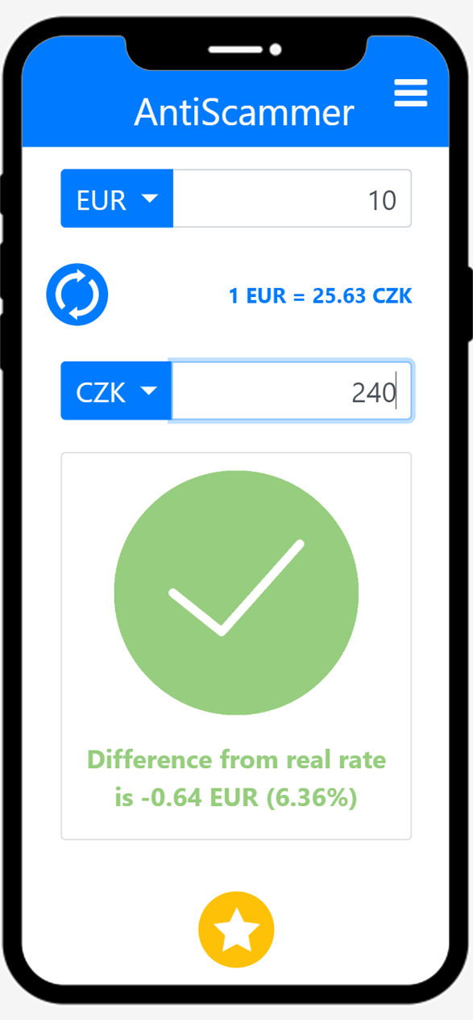
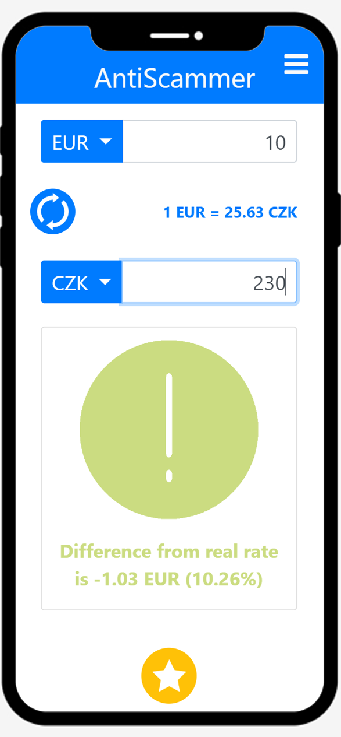
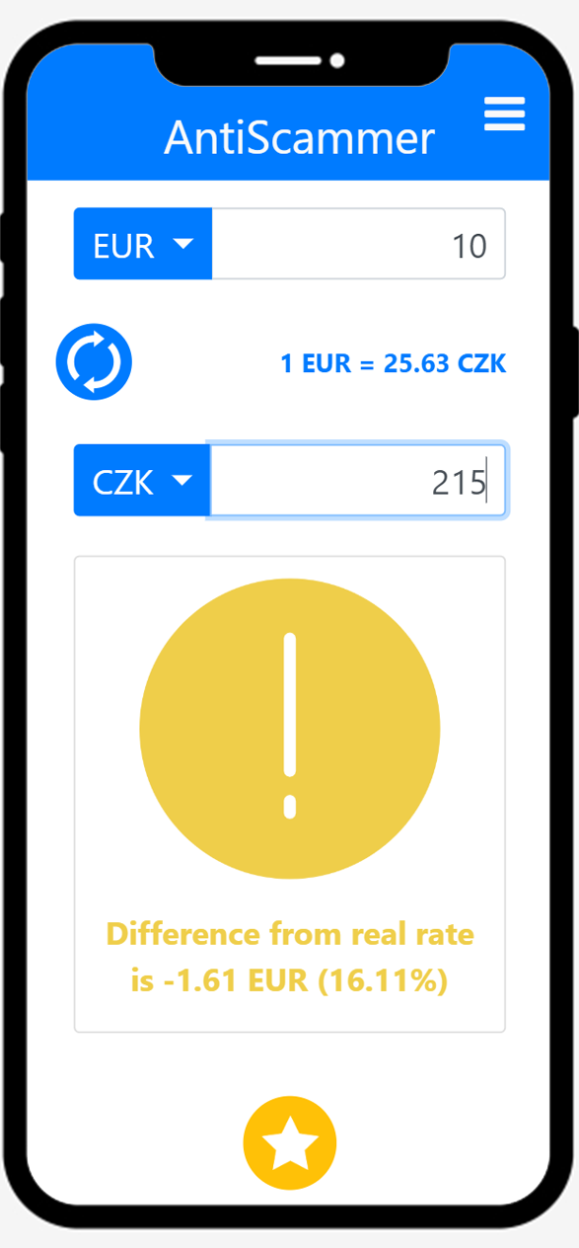
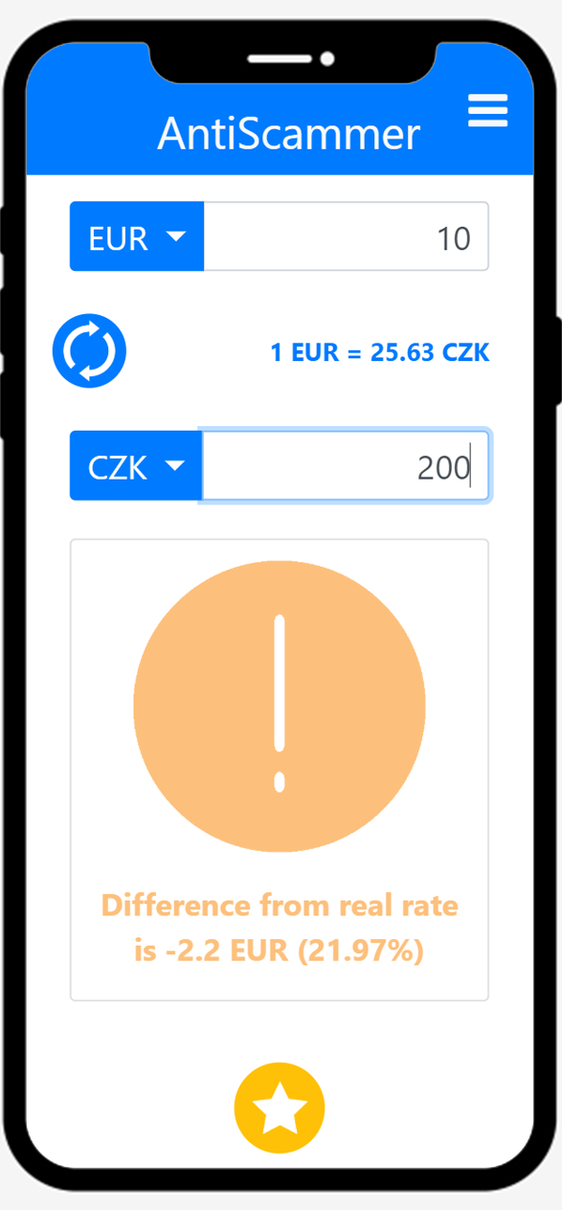
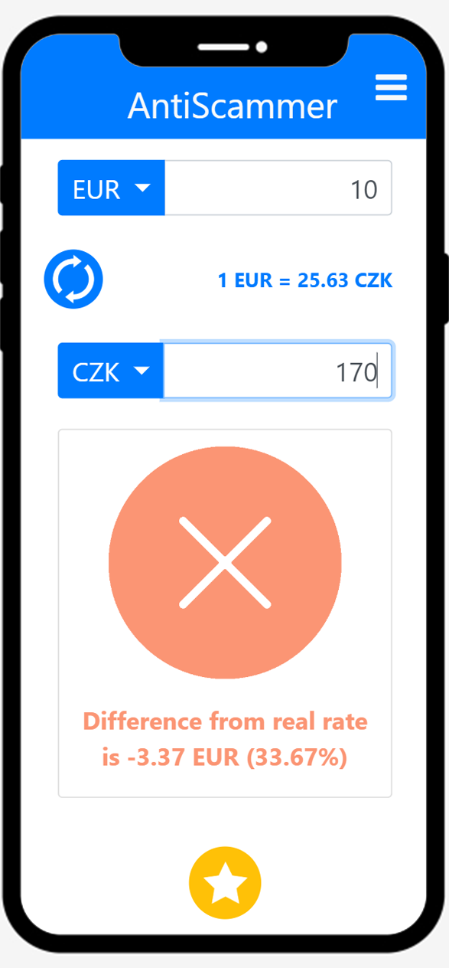
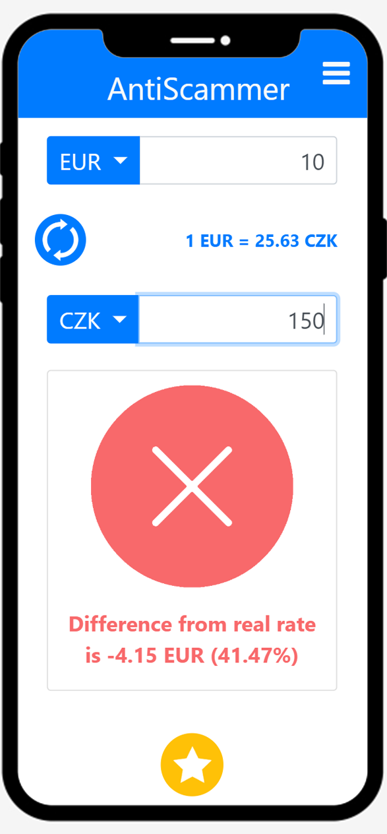

Final Results
<0%
0-5%
5-10%
10-15%
15-20%
20-30%
30-40%
40-50%
>50%

Slide 18
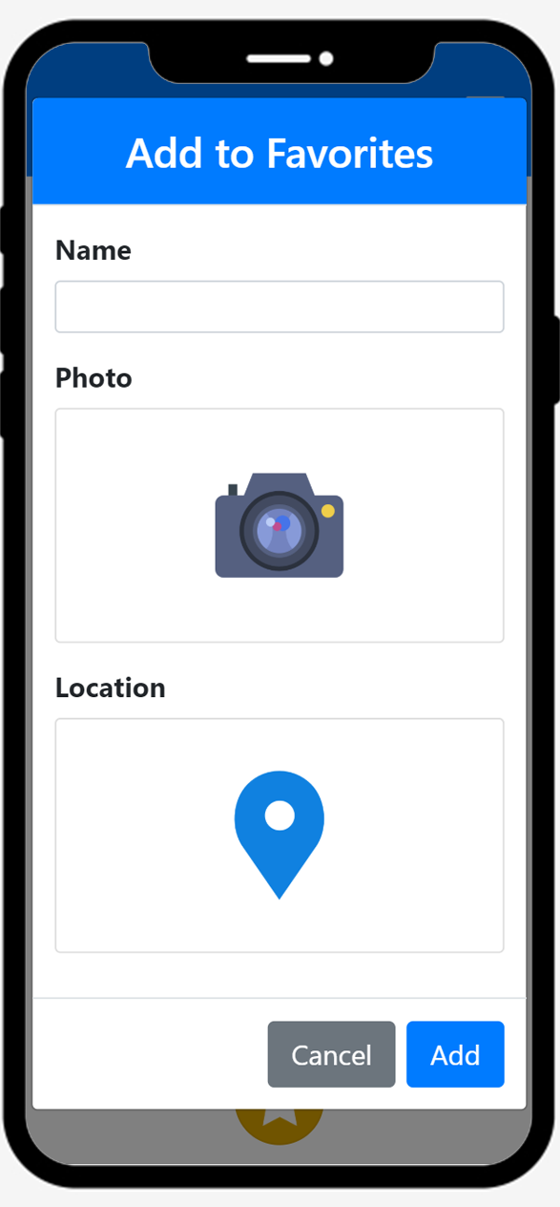
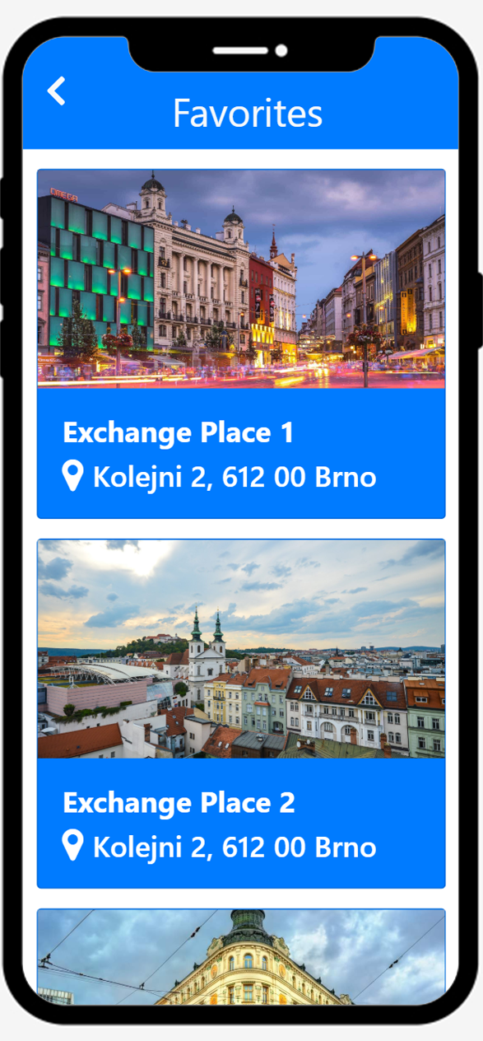
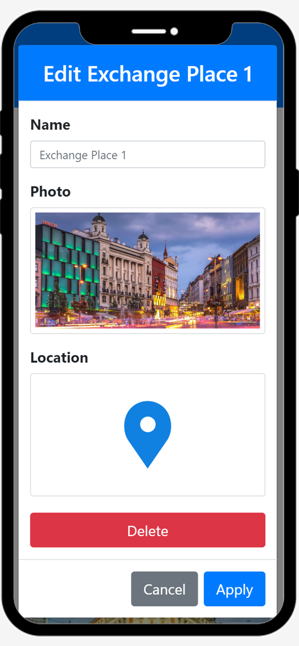
Final – Favorites
Add to Favorites
Favorites
Edit Favorites

Slide 19
Thank you!

